Slide 1
Assignment: Capstone Project
The Battle of Neighborhoods (Week 2)

Slide 2
Introduction/Business Problem
This project will analyze the neighbored of Boston, MA and potential venues of interest.
As someone who is lives in Greater Boston and works in downtown area, I am often asked for recommendations, things to do, and areas to live from friends, colleagues who either live in different US cities or who are travelling to Boston on a work/pleasure trip. A systematic analysis of neighbored and venues not only benefit them but it will be beneficial for me as well at a personal level to explore areas and places which I have not explored.
To successfully complete our analysis, we will need to explore available dataset, explore neighborhood in Boston, analyze each neighborhood, cluster neighborhood and finally examine the clusters.

Slide 3
Data
To perform our analysis, we will need two type of data.
First, we will need location data. For this, we will use foursquare location data which will provide us venues on a given location. We will fetch top 100 venues in nearly 3 mile radius of Boston geographical coordinates.
Second, we would need Boston’s neighborhood data. For this, we will use two sources and merge the data to obtain desired geo coordinates for various neighborhoods. For easy reference, i have downloaded this data in an excel which will be used.
ZIP Code: http://archive.boston.com/news/local/articles/2007/04/15/sixfigurezipcodes_city/
GeoData: https://public.opendatasoft.com/explore/embed/dataset/us-zip-code-latitude-and-longitude/table/?q=boston&refine.state=MA&location=11,42.36681,-71.18952&basemap=jawg.streets

Slide 4
Methodology
Our methodology for this analysis will have following five important component
Explore available dataset: In this section we will access, clean , reshape location and venue data from sources mentioned in above step.
Explore neighborhood in Boston : In this section we will look at different neighborhoods of Boston
Analyze each neighborhood : In this section we will start analyzing the neighborhood data
Cluster neighborhood : We will use k-means to cluster the neighborhood
Examine the clusters: here, we will use the cluster data and examine to understand the top venues.
For our work, we will use different python libraries which are available to us. Some of those are pandas, numpy, json, geopy, matplotlib, folium and sklearn.

Slide 5
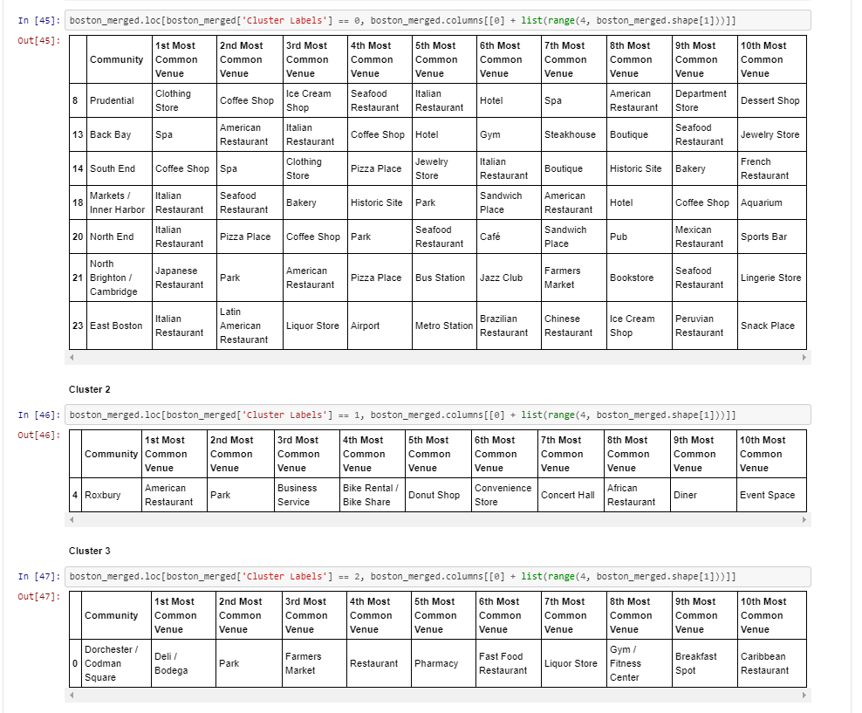
Result

Slide 6
